Slide 1

Demystifying the Ivory Tower
Ellie McKinnon, Alex Struck, Bill Su, and Grayson Thornton

Slide 2
College graduates this year are leaving school as the most indebted class ever... the average class of 2015 graduate with student-loan debt will have to pay back a little more than $35,000.”
-Wall Street Journal
Notes:
http://blogs.wsj.com/economics/2015/05/08/congratulations-class-of-2015-youre-the-most-indebted-ever-for-now/

Slide 3
But is it worth it?

Slide 4
Project Charter
Analyze U.S. University data to understand which universities fit best for students
Identify the best college selection based on individual preferences and ROI
Output a college decision support tool for high school students

Slide 5
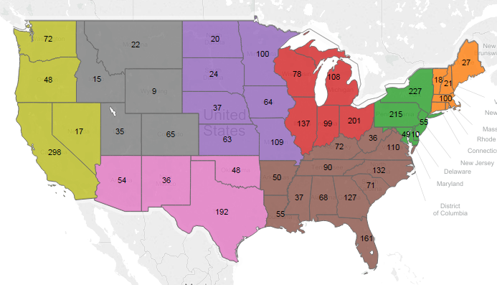
We collected data on 3,846 universities across the States

Slide 6
Data preparation
1,731 variables
200 relevant variables
10 final variables
Admissions rate
SAT math scores
SAT verbal scores
Region
Graduating debt
Locale
Full-time faculty
Number of undergraduates
Average income
Major Cluster

Slide 7
Clustering allows us to predict ROI based on type of major
Professional
Comprehensive
Specialized
Daymar College
A professional college often comes in the form of a community college. They offer a number of majors for students who aim to go directly into a specific profession.
University of Virginia
A comprehensive college offers a complete education with many major options. Students attending a comprehensive college usually desires a liberal arts education with many possibilities for study.
Babson College
A specialized college is only for the student who knows what they want to study. Usually offering only one or two majors, the specialized college focuses its expertise only on a small area of study.

Slide 8
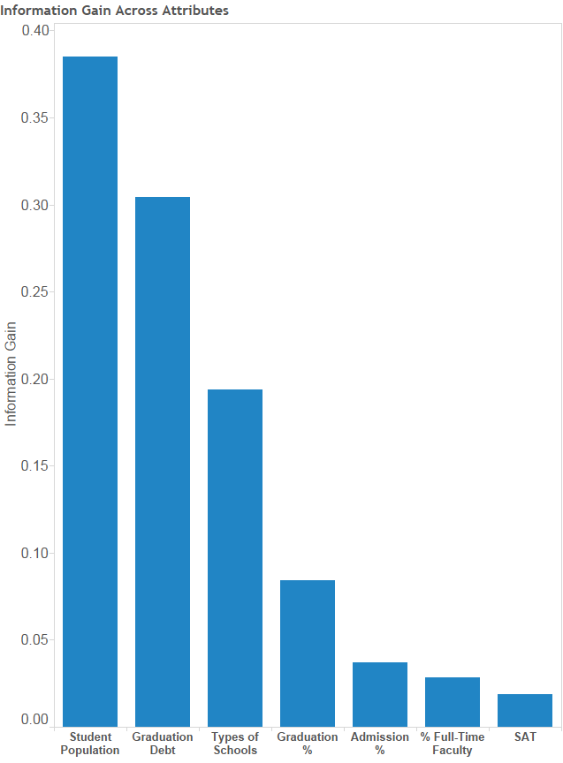
Model reveals unexpected indicators of college ROI
Weighting by information gain and Gini coefficient we find:
Number of students and median debt after graduation are the two most important indicators of ROI
Proportion of full time faculty, admission rate, and SAT score are very poor predictors of college ROI

Slide 9
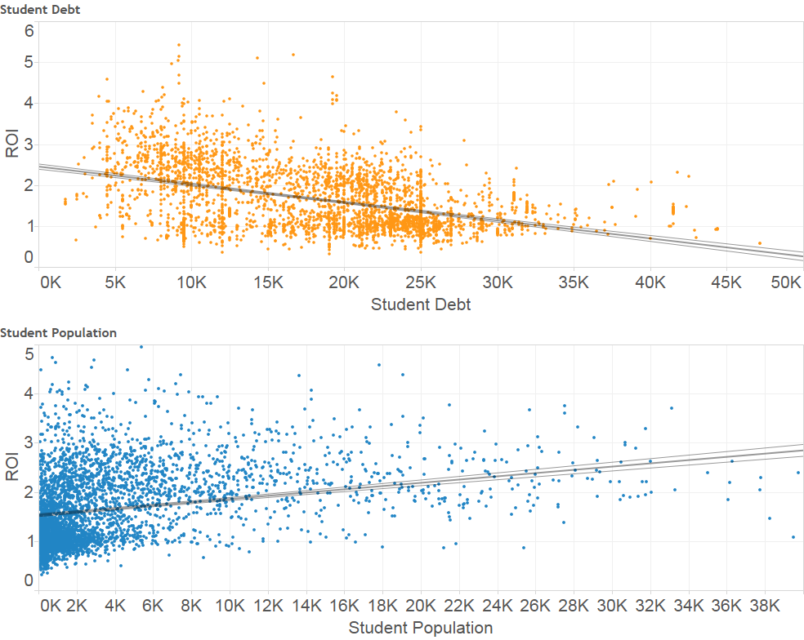
Student debt and population have the largest impact on ROI

Slide 10
Regression coefficients illustrate the relationship between major cluster and ROI
Professional
Coeff = .029**
Comprehensive
Coeff = -.093**
Specialized
Coeff = .063**
Daymar College
City University of Seattle
Lake Washington Institute of Technology
ITT Technical Institute
University of Virginia
Harvard University
University of Michigan
University of Southern CA
Virginia Tech
Duke
Babson College
CA Institute of the Arts
Bon Secours Memorial College of Nursing
Clover Park Technical College

Slide 11
Predictive Modeling with Random Forest generated an accuracy of 70%
Confusion Matrix | true Medium | true High | true Low | class precision
pred. Medium | 354 | 21 | 72 | 79%
pred. High | 25 | 40 | 3 | 59%
pred. Low | 103 | 2 | 149 | 59%
class recall | 73% | 63% | 67%
We have created a Random Forest Model that is able to predict college return on investment with high accuracy, assisting high school students’ college decision.

Slide 12
Introducing...
Lookup tool
ROI prediction
&

Slide 13
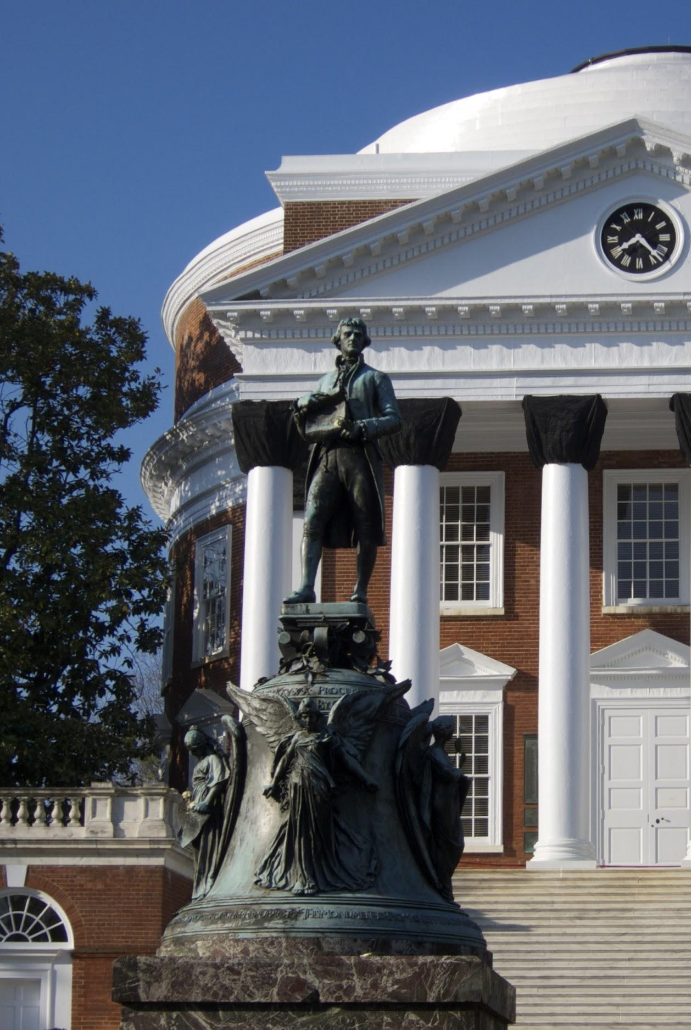
Our data tool can be improved with the incorporation of more variables
College dining rankings
Most beautiful campus rankings
City rankings
Other rankings

Slide 14

Picking a college is an intimidating decision
Our data tool empowers high school students to make more informed decisions when selecting a college.

Slide 15
Thanks!
Any questions?

